Slide 1
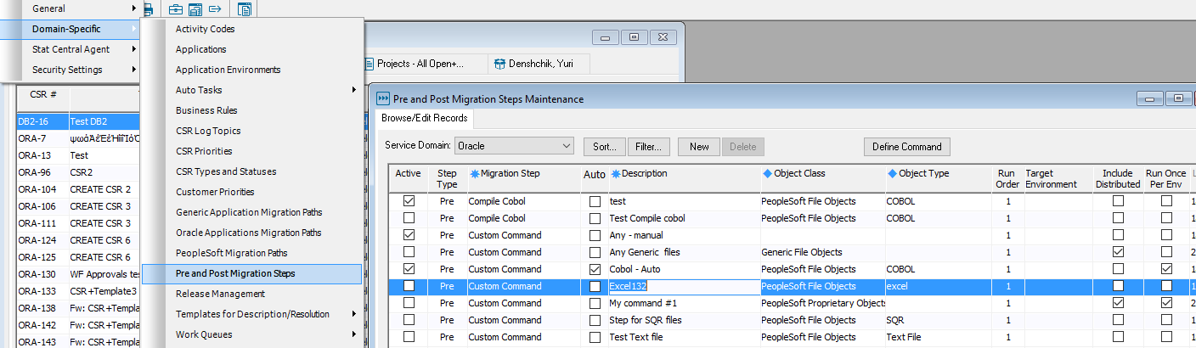
Automated Pre and Post Migration Steps for custom commands
Combined Pre and Post Migration Steps maintenance windows
- “Auto” checkbox for custom commands

Slide 2
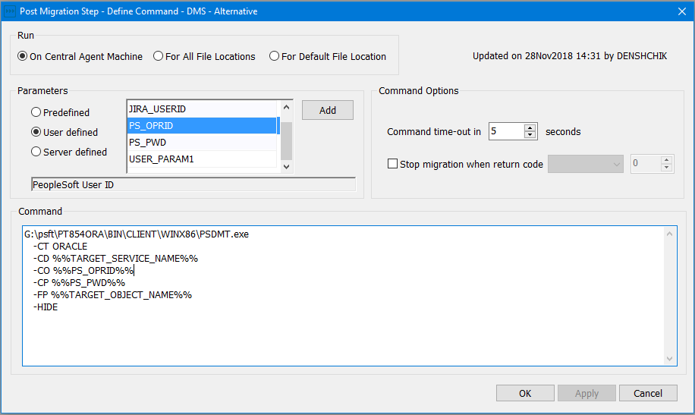
Automated Pre and Post Migration Steps for custom commands (continue)
Redesigned Command editor

Slide 3
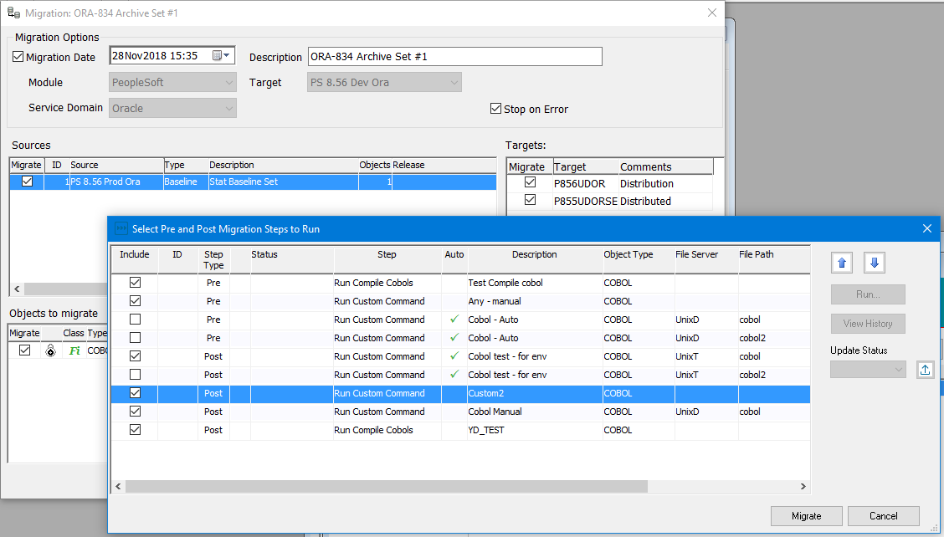
Automated Pre and Post Migration Steps for custom commands (continue)
Select Pre and Post migration steps

Slide 4
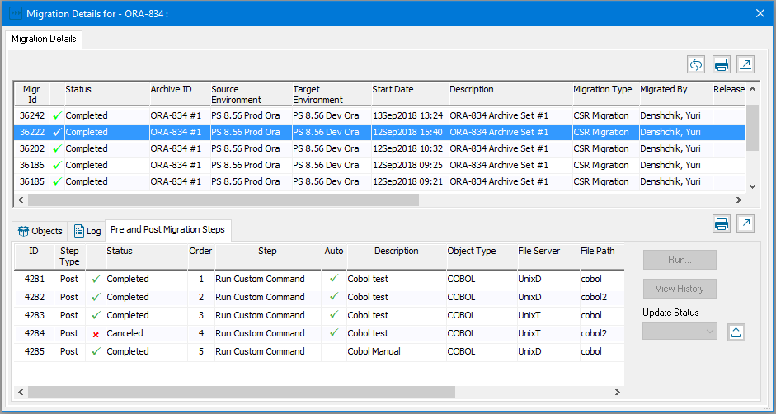
Automated Pre and Post Migration Steps for custom commands (continue)
View and Execute Pre and Post migration steps from Migration Details Window

Slide 5
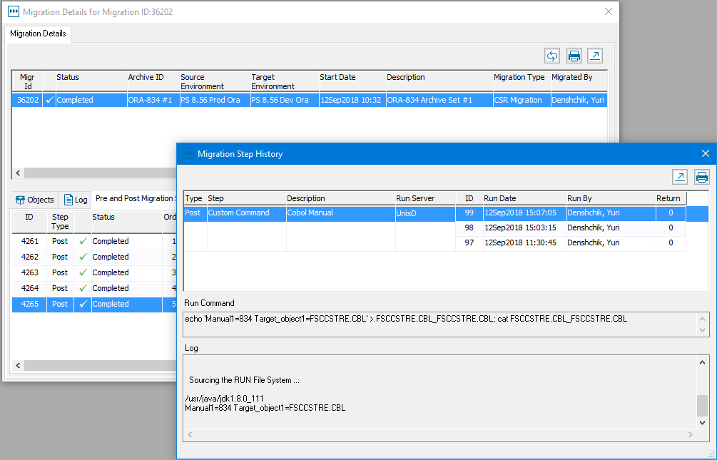
Automated Pre and Post Migration Steps for custom commands (continue)
Migration Step History

